Slide 1
Predicting Food Inspection Outcomes of Chicago Restaurants
Andrew Brennan and Joe Reilly
CS109a
12/09/2016

Slide 2
GOAL
Analyze historical data of Chicago food inspections and develop a model to predict the inspection outcome
More than 15k establishments per year with less than 36 inspectors
~22% are critical failures
The longer a restaurant operates with a violation, the greater risk to public health
Prioritize inspecting restaurants that rank highly on our metric

Slide 3
Data Exploration / Cleaning
Possible predictors:
Inspection data (risk level of establishment, licensing, type of establishment, address)
Weather data
311 data (garbage and sanitation complaints)
Complaint and “regular canvass visits” only
Retail food establishments only
n = 61,727 inspections (52.3% of original)

Slide 4
Significant Variables & Performance Metric
Outcome of previous inspection
Inspection type (complaint versus canvass)
Risk score
Location in the city
Facility Type
Performance metric: maximize the likelihood of the observed data given the model
Score models based on joint probability of obtaining observed data from that model

Slide 5
Techniques Applied
Simple averaging:
Predict by simply averaging outcome probabilities at same location and time from previous data.
Multinomial logistic regression:
Baseline model (including location and day of week)
Better models (include insp type, fac type)
Even better models (including last inspection results for that restaurant)
Other methods:
QDA, k-Nearest Neighbors, Random Forest

Slide 6
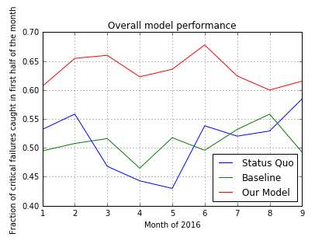
Findings
Logistic regression with all significant variables
41% probability of obtaining observed data
QDA and Random Forest both performed worse
k-NN approaches 41% probability with n > 75
Very computationally expensive, overfits
Using our model, 15% more failures detected in the first half of the month versus “business as usual”

Slide 7
Future Work
Interaction terms (sanitation * zip?)
Other types of establishment
Different binning of categorical data
Utilize user reviews (Yelp, Trip Advisor) to assess conditions of an establishment

Slide 8
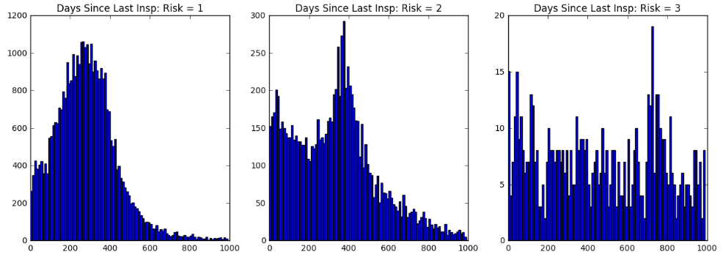
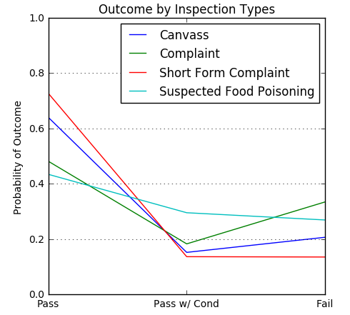
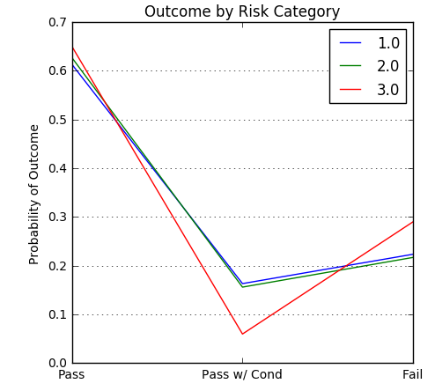
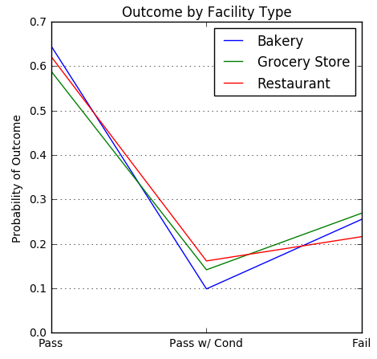
Relevant Predictors

Slide 9
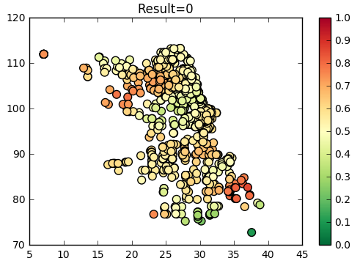
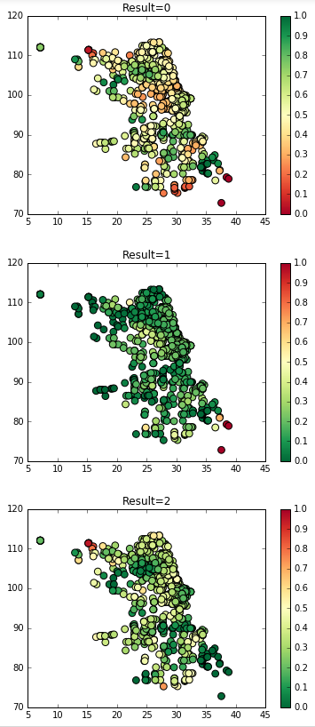
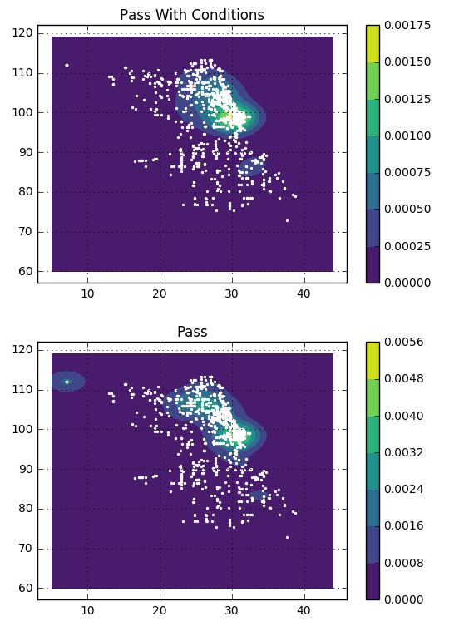
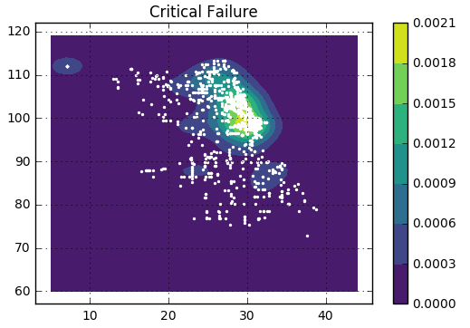
Kernel Density Estimation of Inspection Results
Heatmap of Different Results

Slide 10
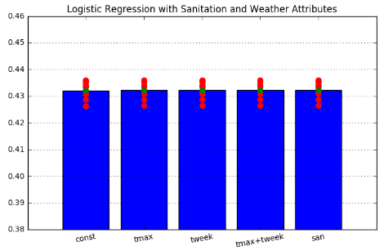
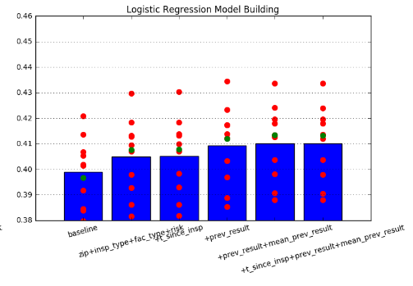

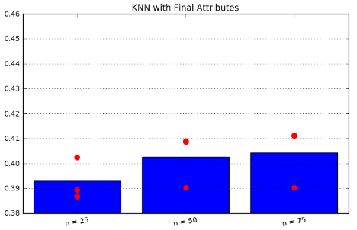
Model Selection

Slide 11
